Slide 1


DDD and FP Can’t Be Friends, Yet
Mike Sperber Henning Schwentner

Slide 2


Slide 3

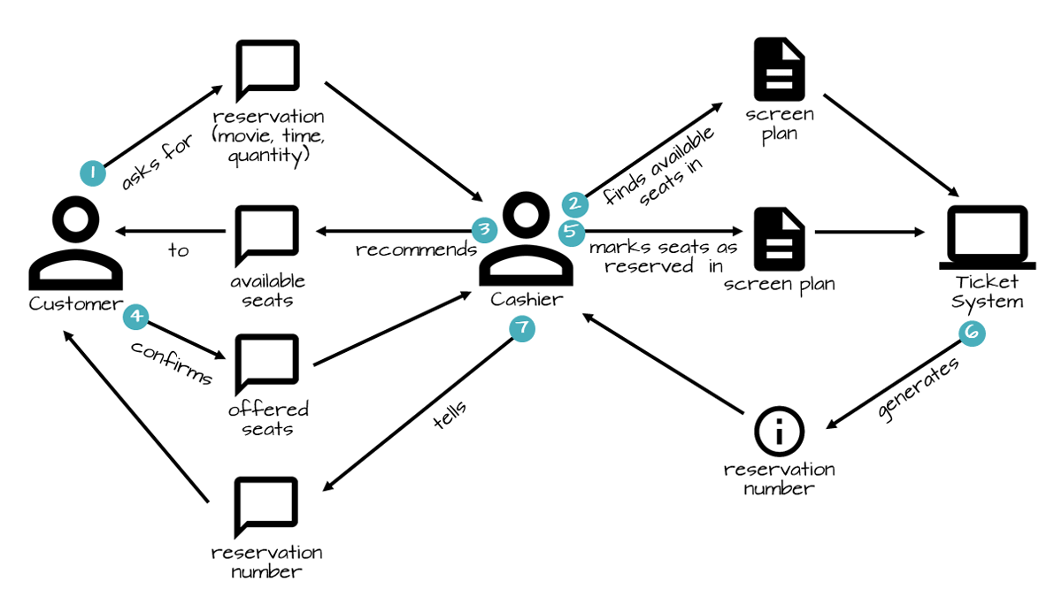

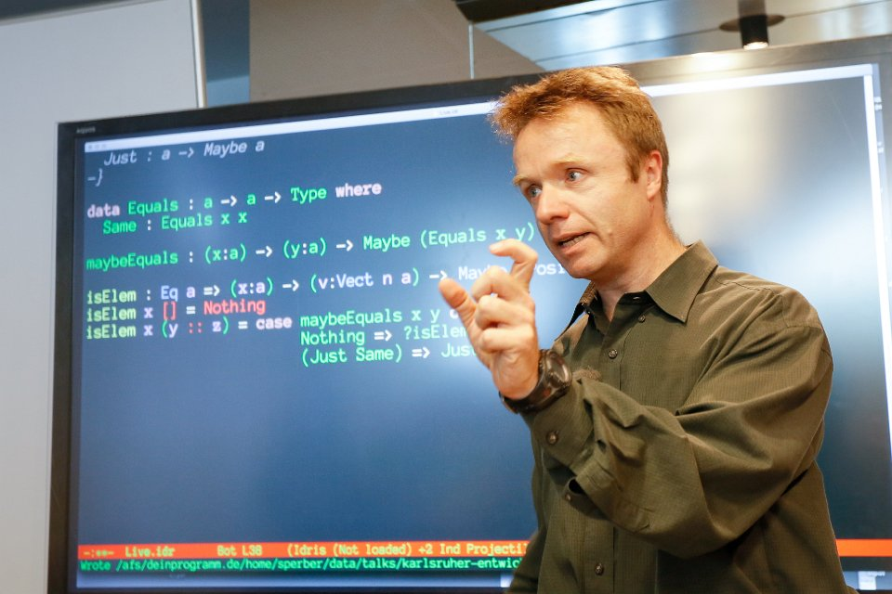




Slide 4
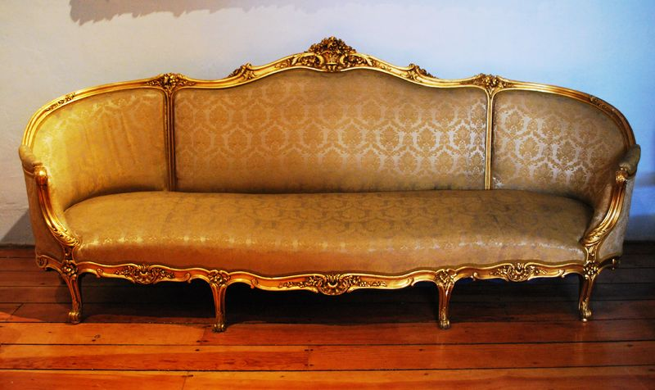
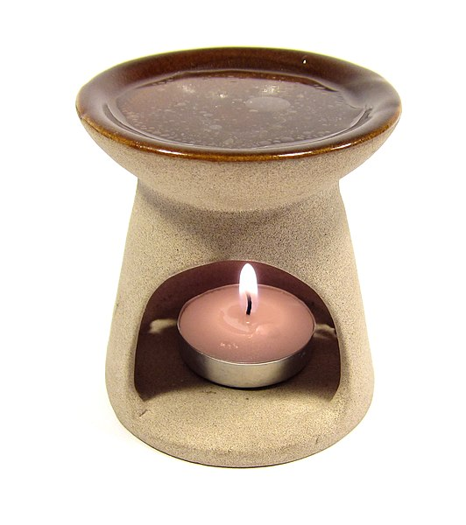
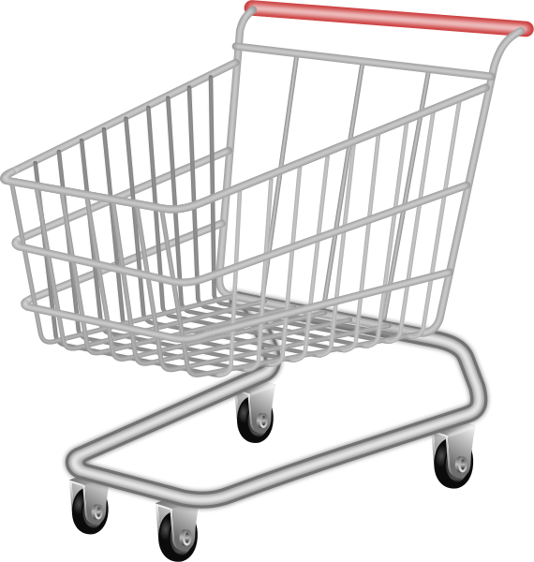
AEKI Shopping Cart
put articles in cart—always
go to checkout
choose shipping address
no shipping furniture to Packstation
don’t lose input data
Source: Wikimedia (sofa), Wikimedia (candle diffuser)

Slide 5
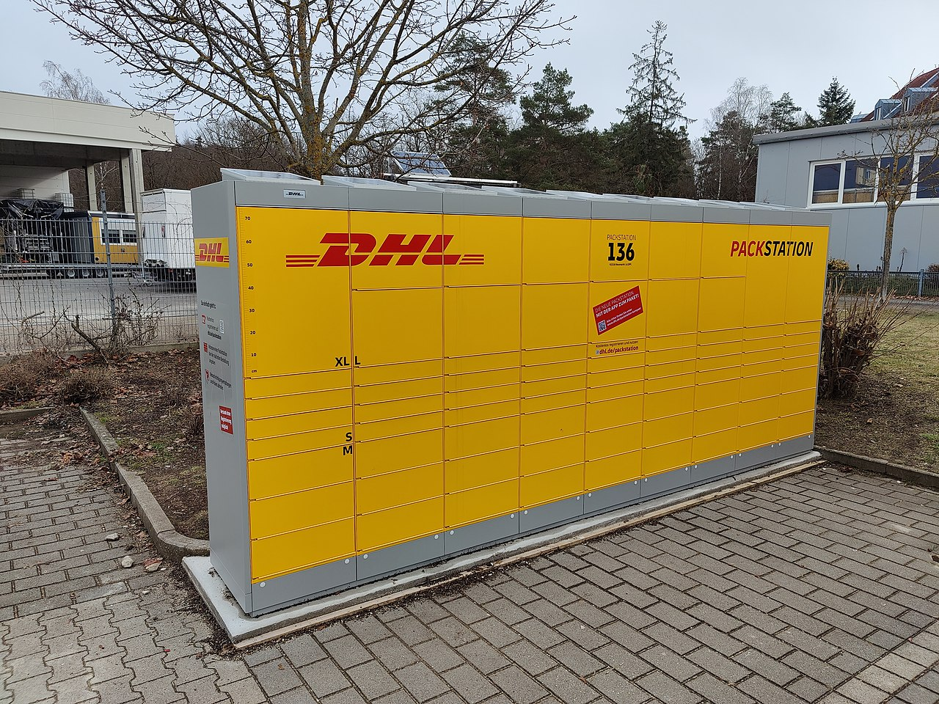
Packstation
Source: Wikipedia

Slide 6
States
Draft Cart
Checkout-Ready Cart
Checked-OutCart

Slide 7
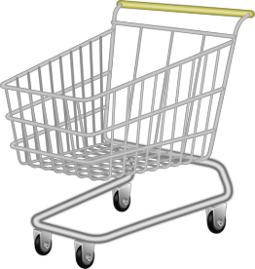
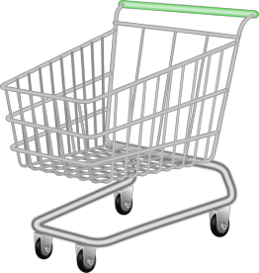
Ubiquitous Language vs. Abstraction
“shopping cart”
“monoid,” “monad”
domain things—DDD ✅, FP 🤷
implicit/emergent domain things 🤼‍♂️ ❓
domain-independent abstractions FP/mathematics ✅
Notes:
These Henning: Naming things is important for DDD people, and be honest FP people are not great in that

Slide 8


Simplicity vs Generality
“Before Reuse Comes Use”
“Abstraction, abstraction, abstraction”
simplicity
generality
Notes:
these Henning:

Slide 9
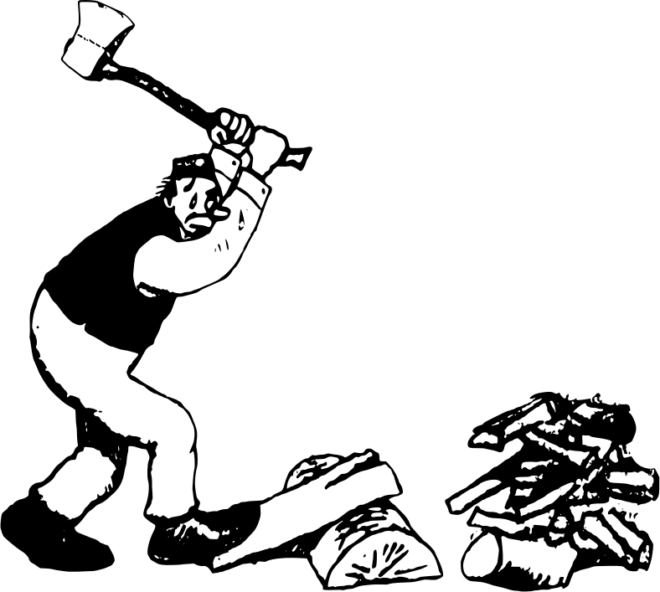
BDD vs. Design Recipes

Slide 10
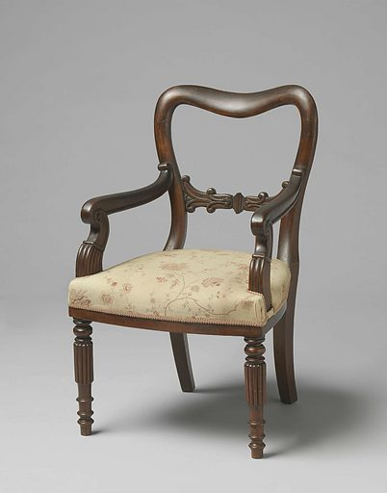
Entities vs. Value Objects vs. Domain
difference well-defined?
good for what?
domain or technology?
Notes:
Mike: we haven’t talked about Entity vs Value and we will not talk about it now.

Slide 11

... and What About Mutability?
ideology?
pragmatics?
technology?
situational?
2024?
Notes:
Henning: Also, we havent talked about mutabilty
— maybe we will next year.

Slide 12



What Is It That We’re Modeling?

Slide 13
Not Friends, Yet
Collaborative Modeling Processes
Strategic Design Ubiquitous Language
BDD Operation Signatures
TDD Test Cases & Functions
Design Recipes Data Analysis
Design Recipes Functions
Abstraction Types

Slide 14


software project development
many different fields
functional programming
training, coaching
iSAQB-accredited Functional Software Architecture
www.active-group.de
funktionale-programmierung.de
Mike Sperber
@sperbsen@discuss.systems
Notes:
nie in OOP sozialisiert

Slide 15
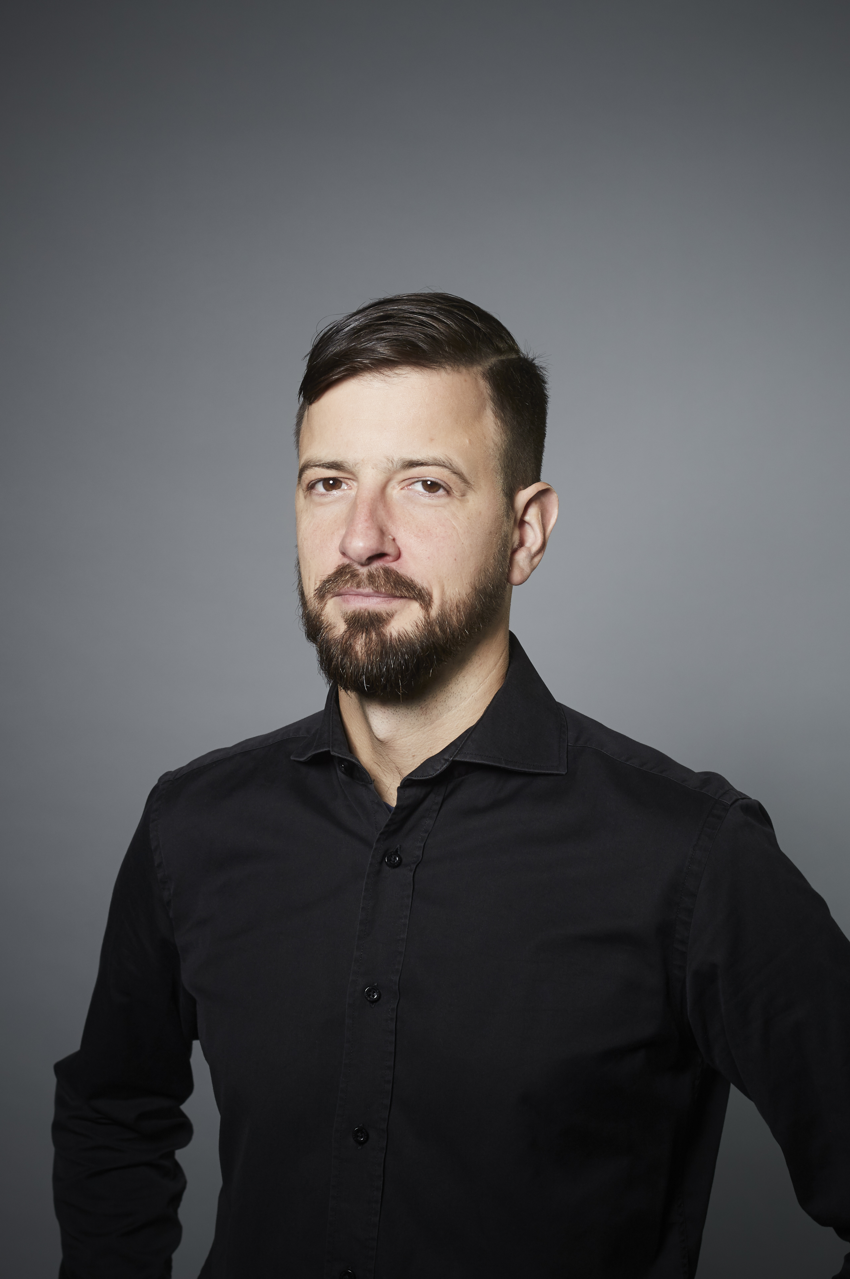

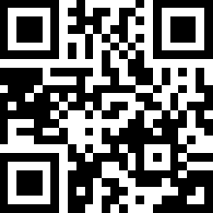
Henning Schwentner
 https://hschwentner.io
 @hschwentner
→ hs@wps.de
Notes:
Book and slides: Homepage

